Slide 1

Conversational Intelligence for BWC Enforcement Audio
Automating SOP compliance and risk detection in high-stakes civil enforcement interactions.

Slide 2




System Operational Objectives
Procedural Compliance
Escalation & Safety
Visit Outcomes
Was identity confirmed? Was legal authority explained? Were payment options clearly offered according to SOP?
Detection of raised voices, threat language, or hostile behavior indicating immediate risk to agents or debtors.
Categorization of results: Payment collected, plan agreed, entry refused, or goods levied for structured reporting.

Slide 3

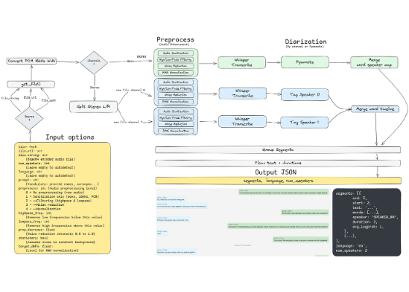
Environmental Audio Challenges
Acoustic Hostility
High-velocity wind and traffic noise
Clothing rustle and microphone friction
Rapid speaker switching & interruptions
Distant far-field speech and shouting
Research Insight: BWC conditions significantly degrade ASR word error rates (WER) compared to clean data.

Slide 4


Literature & Research Gap
State of the Art
The Research Gap
WhisperX: VAD-assisted segmentation and forced alignment for ASR.
Pyannote.Audio: Neural diarization for speaker clustering.
Current systems prioritize pure transcription. There is a critical lack of focus on Operational Intelligence—extracting compliance and escalation reasoning from messy, real-world enforcement audio.
MSDD: Robust handling of short, overlapping utterances.

Slide 5
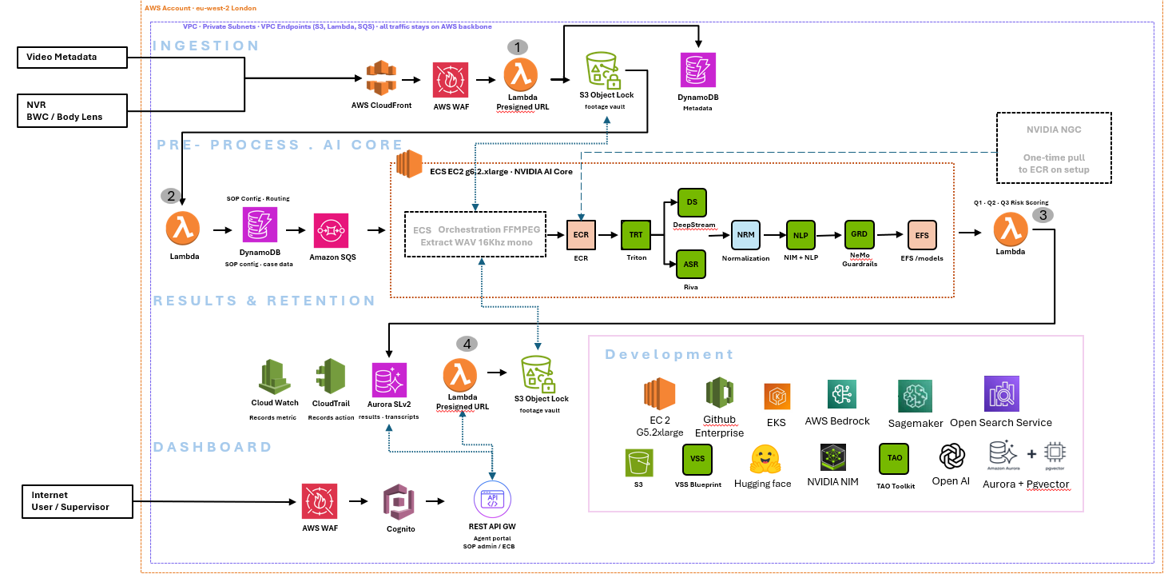
Architecture 1

Slide 6

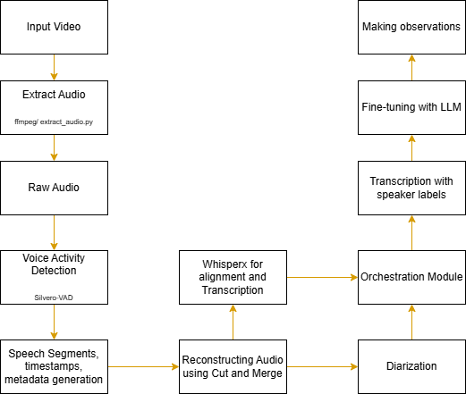
Conversational Processing Pipeline
System Orchestration
Implemented: Stage 1, VAD and stage 2 Alignment and world-level timestamps with WhisperX.
Current Path: Moving into Stage 3 Diarization to resolve speaker identity.
Optimization: Reconstructing audio using "Cut and Merge" logic for improved segment context.

Slide 7



Evaluation & Benchmarking Strategy
Attribute Identification
Error Localization
Reverse Engineering
Isolating orthogonal features and identifying the best metrics to benchmark each pipeline stage independently.
Systematically finding what is harming results at each step (VAD vs. ASR vs. Diarization) to iterate on specific bottlenecks.
Studying results and reverse engineering performance gaps to refine the framework and improve the final solution.

Slide 8


Optimized Benchmarks
Key Improvements
Model Component | Initial Result | Optimized Result
VAD Accuracy | 73.51% | 78.37%
VAD F1 | 79.82% | 84.93%
Alignment Coverage | 79.3% | 81.4%
Boundary Error | 1.46s | 1.29s
84.93%
VAD F1 SCORE (OPTIMIZED)
29.07%
WHISPER LARGE-V3 WER
Major Finding: ~30% reduction in ASR deletion errors through optimized speech padding and segment gap management.

Slide 9



Current Bottlenecks
Speaker Attribution
Environmental Artifacts
Fine-Grained Truth
Resolving short, explosive utterances and overlapping speech in emotionally charged encounters remains the primary diarization hurdle.
Wind and mechanical noises can still trigger false positives in VAD, impacting downstream transcription quality.
Ground-truth data is often coarse, while model predictions are hyper-granular, complicating precise alignment evaluation.

Slide 10
Immediate Research Path
Focus: Stage 3 (Diarization)
The LLM Intelligence Layer
Pyannote.Audio DER benchmarking
Automated SOP event extraction
Overlap handling for multi-speaker logic
Escalation reasoning & sentiment shifts
Unified timeline orchestration layer
Outcome validation vs. agent reports

Slide 11

Key Takeaways
Operational Audio Is Fundamentally Different
Compared to clean speech datasets, BWC audio introduces:
Severe environmental noise
Rapid speaker transitions
Emotional escalation
Overlapping speech
which significantly degrade both ASR and diarization.
Final Objective
Generate accurate speaker-attributed conversational timelines that support:
Compliance analysis
Escalation assessment
Outcome determination
Operational decision support

Slide 12


Image Sources
https://miro.medium.com/v2/resize:fit:1400/0*cLzBHDXI4CwJzjVp
Source: medium.com
https://d2908q01vomqb2.cloudfront.net/f1f836cb4ea6efb2a0b1b99f41ad8b103eff4b59/2025/10/27/ml-157041-887x630.png
Source: aws.amazon.com

